Slide 1
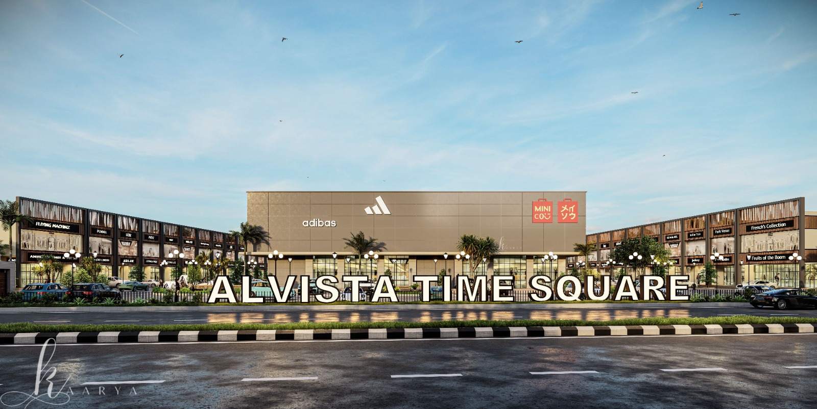

Welcome to Alvista Time Square
PROJECT BY ALVISTA
LAND TO LANDMARK
Located on GT Road Bathinda adjoining D-MART, the nearest approved project to the proposed bus stand.

Slide 2
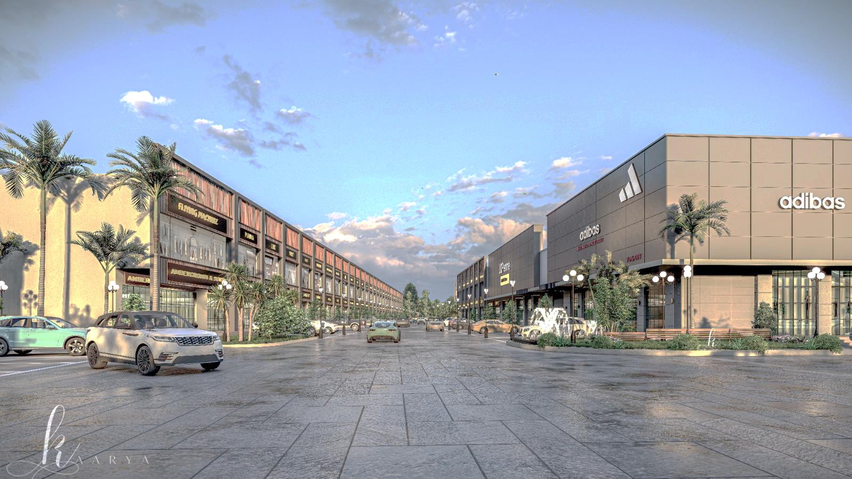
Table of contents
Project Overview
Highlighting the Alvista Time Square Project
Unveiling the 6.37 Acres of Luxury
Experience Anchor Stores Like Never Before
Drive Thru Convenience at Your Fingertips
Ample Parking for Your Convenience
RERA Approved Excellence at Time Square
Nearest Approved Project to Proposed Bus Stand
Your Gateway to a Beautiful Project Site
Incorporates innovative and modern architectural designs.

Slide 3
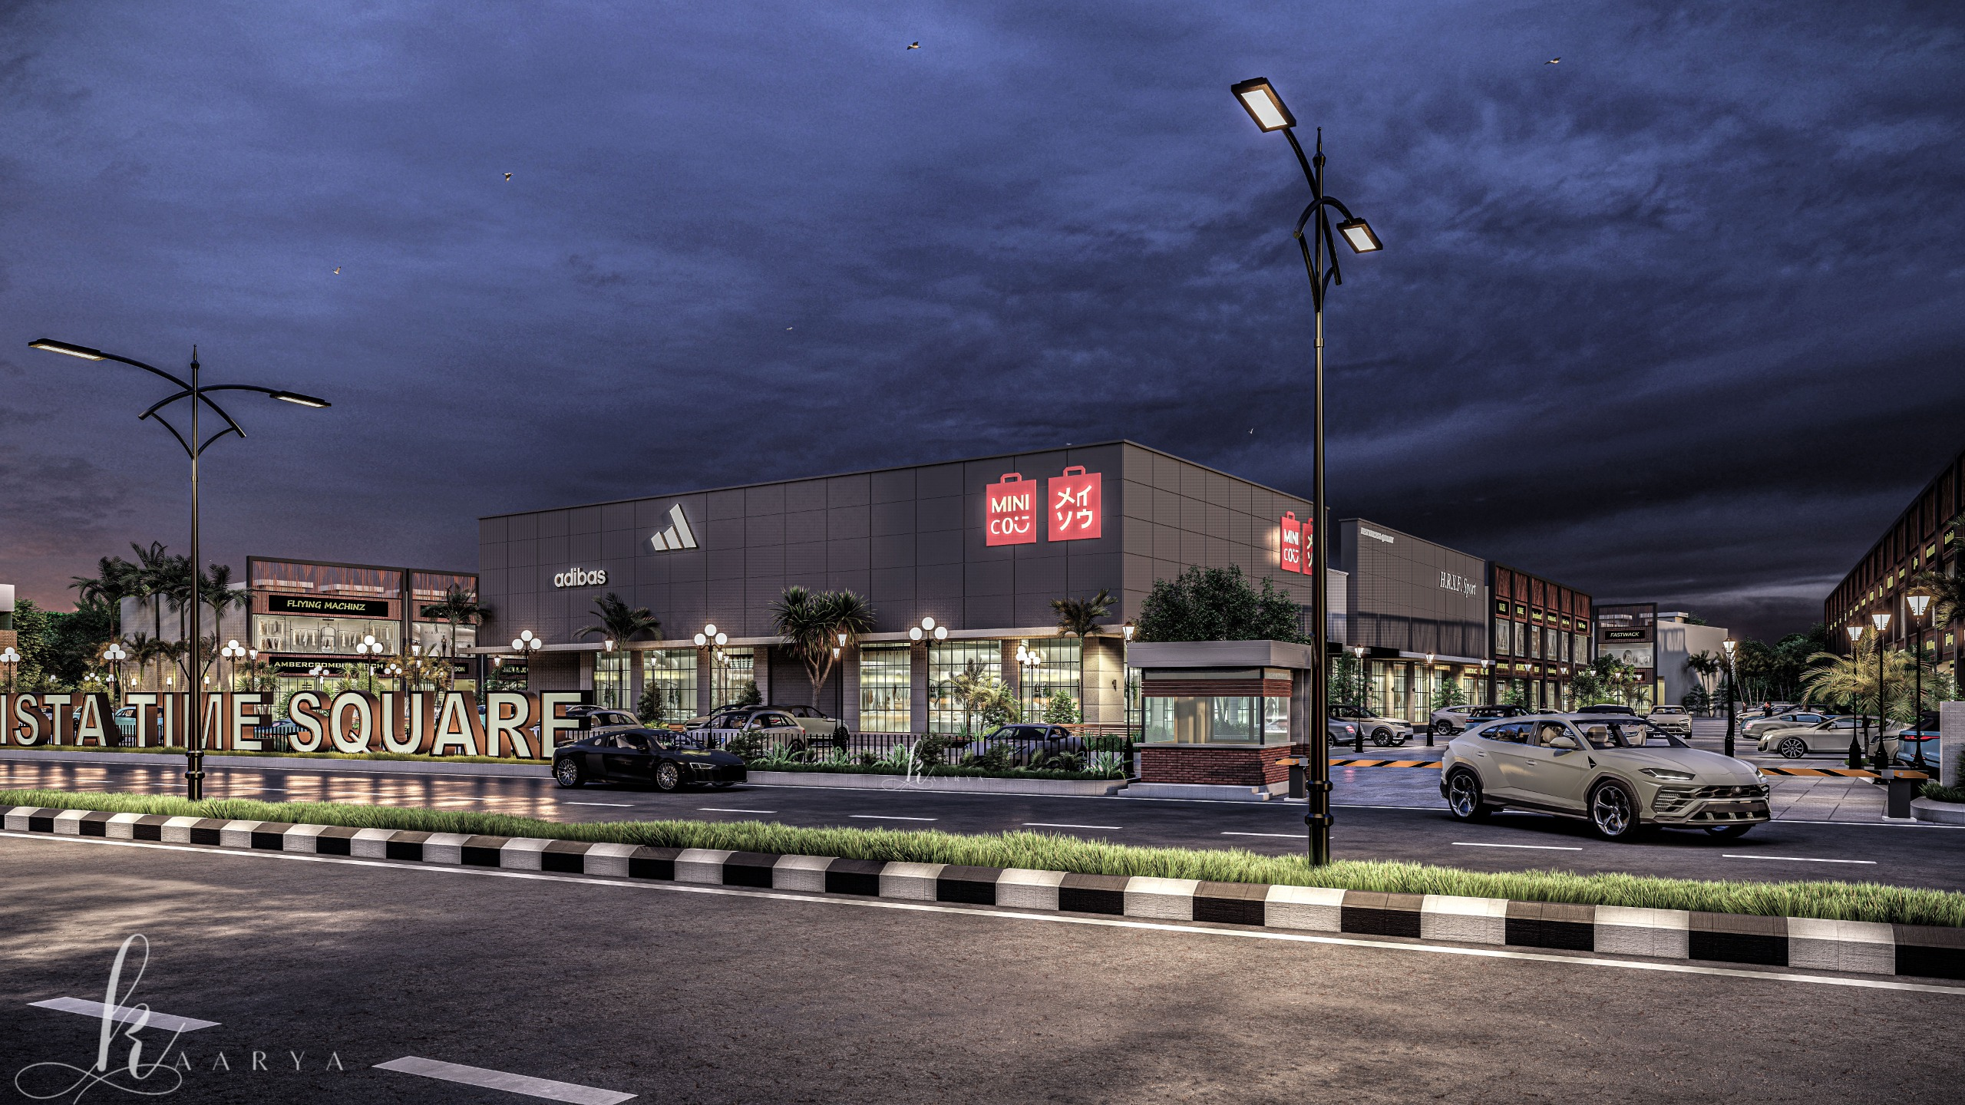
RETAIL IMPACT
Anchor Stores
Importance of Anchor Stores in Driving Foot Traffic and Business Success
Anchor stores are large retail stores that attract significant foot traffic and serve as the primary attractions in shopping malls.
Anchor stores play a vital role in drawing customers to the shopping center, benefiting other retailers by increasing overall visitor numbers.
The presence of anchor stores contributes to the overall success of the project by creating a strong retail environment and enhancing the project's visibility.
Having anchor stores can make the project more appealing to potential tenants by showcasing a diverse mix of established brands and attracting a broader customer base.
Definition of Anchor Stores
Foot Traffic Generation
Boost to Business Success
Enhanced Tenant Attraction

Slide 4
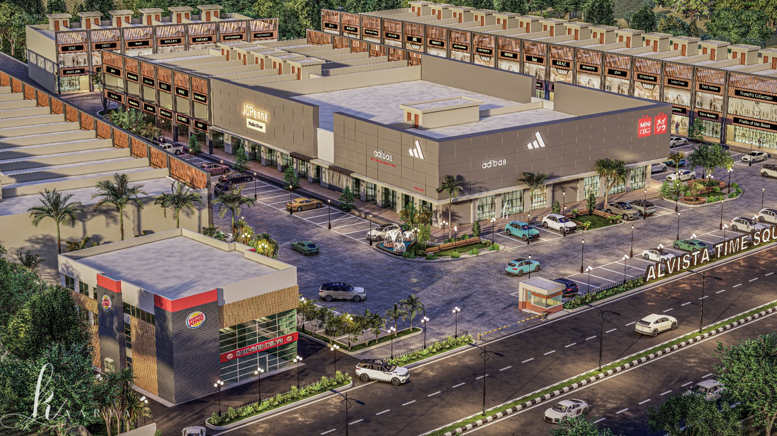
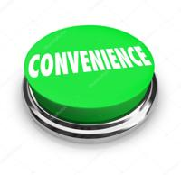

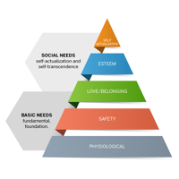
CUSTOMER CONVENIENCE
Drive-Thru Facility
Enhancing Customer Experience through Convenience
Quick Service
The drive-thru facility ensures rapid service, reducing waiting times for customers.
Convenience
Customers can enjoy the convenience of staying in their vehicles while accessing products or services.
Increased Sales
The drive-thru feature has the potential to boost sales by catering to customers seeking fast and efficient transactions.
Modern Consumer Needs
This facility aligns with the modern consumer's preference for speed and convenience in their shopping experience.

Slide 5
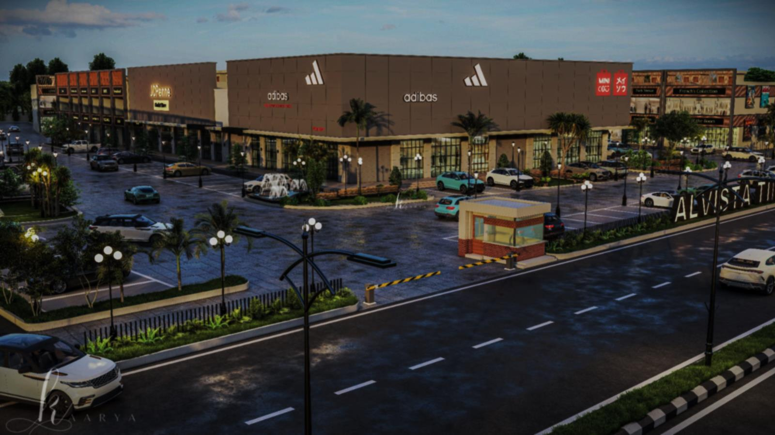
PARKING FACILITIES OVERVIEW
Spacious Parking
Enhanced Parking Experience at Alvista Time Square
Capacity of 300 Vehicles
The parking area accommodates up to 300 vehicles simultaneously, ensuring ample space for visitors.
Enhanced Security Measures
Advanced security systems and surveillance ensure the safety and protection of vehicles parked within the premises. 24/7 Security Surveillance
Convenient Layout
Designed with a user-friendly layout, the parking facilities offer easy navigation and accessibility. Accessible parking spaces are available for individuals with special needs, ensuring inclusivity for all visitors.

Slide 6

REGULATORY COMPLIANCE
RERA Approved Project
Enhancing Credibility and Protection RERA no. PBRERA-BTI08-PC0247
Consumer Rights
Regulatory Compliance
Safeguards consumer rights and interests, promoting fair dealings and dispute resolution.
Demonstrates adherence to RERA regulations, ensuring transparency and accountability.
Customer Assurance
Investor Confidence
Offers customers security against project delays and misrepresentation, fostering trust.
Boosts trust among investors by providing legal protections and project legitimacy.

Slide 7
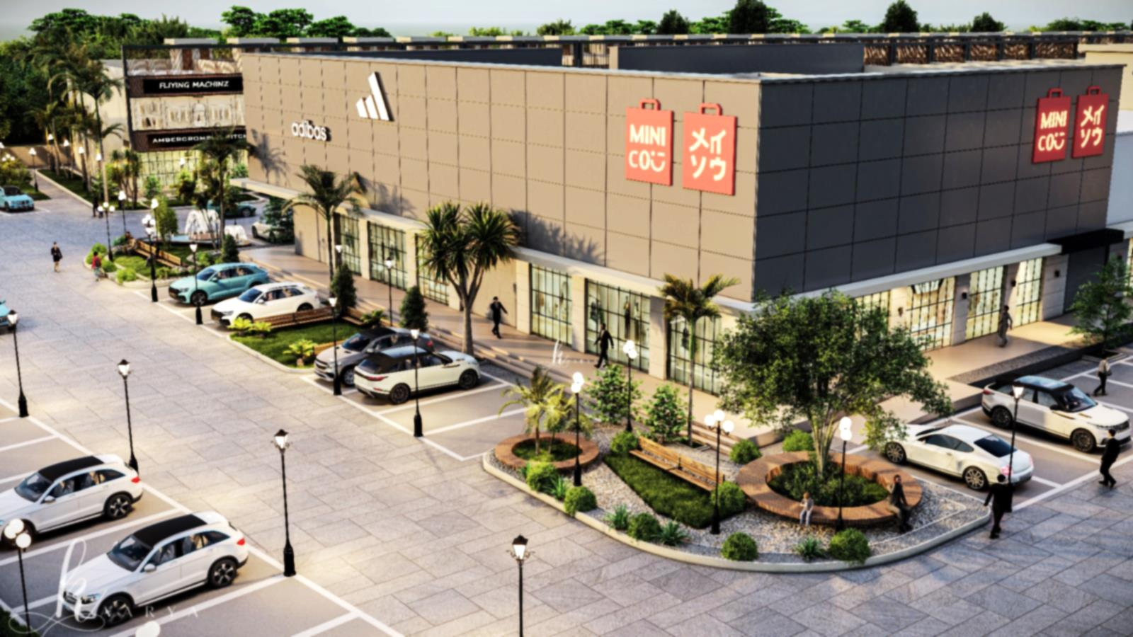
ENVIRONMENTAL IMPACT
Abundant Green Spaces
Enhancing Well-being and Sustainability
Green open seating areas offer residents spaces for relaxation, social interaction, and recreational activities.
Increased Oxygen Levels
Natural Cooling Effect
Biodiversity Promotion
Community Recreation

Slide 8
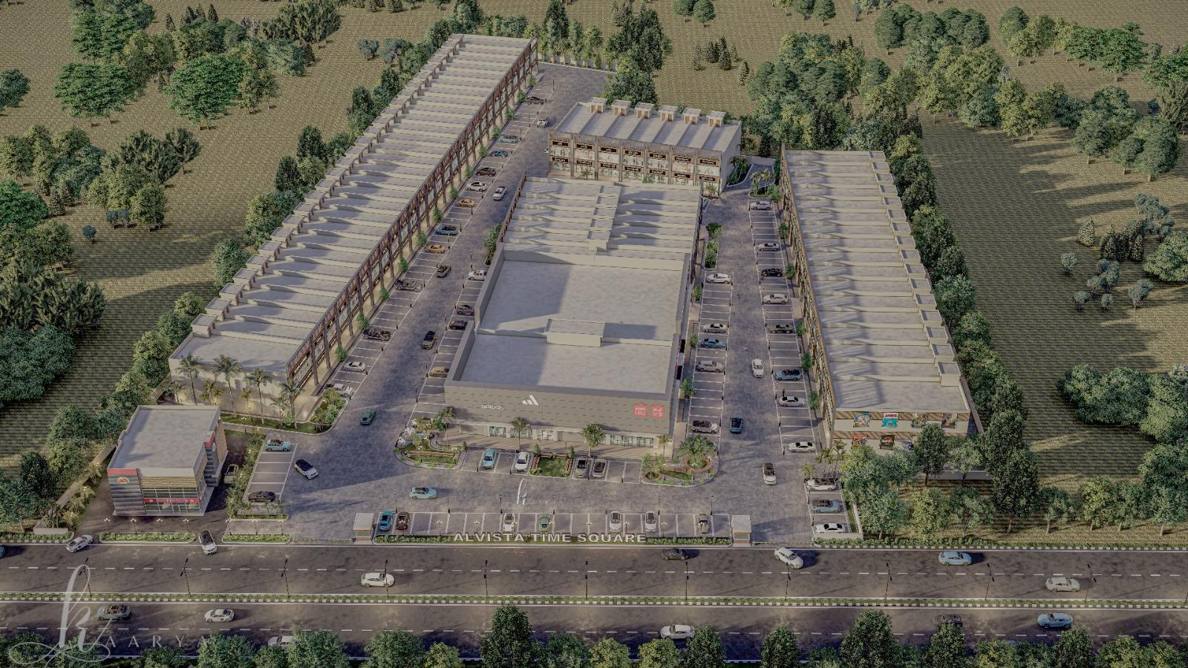
FEATURES AND AMENITIES
1. Landscaping and Outdoor Spaces:
4. Signage and Branding:
Well-maintained landscaping with greenery, trees, and flowers.
Paved walkways and pathways for easy navigation around the property.
Outdoor seating areas or benches for relaxation and socializing.
Water features such as fountains or ponds to enhance the aesthetic appeal.
Clear and visible signage displaying the name and logo of the commercial outlet.
Directional signs to guide visitors to different areas of the property.
Illuminated signage for visibility at night.
2. Parking Facilities:
5. Outdoor Amenities:
Ample parking spaces for owners and visitors.
Designated parking areas for different types of vehicles (cars, motorcycles, bicycles).
Recreational areas such as outdoor seating, picnic areas, or green spaces.
Outdoor lighting for safety and ambiance.
3. Security Measures:
6. Exterior Maintenance:
Perimeter fencing or walls for added security.
Security lighting to illuminate the exterior of the building.
Security cameras and surveillance systems for monitoring the premises.
Security patrols or on-site security personnel to ensure safety.
24/7 security surveillance and on-site security personnel.
Regular landscaping and grounds maintenance to keep the property looking attractive.
On-site maintenance staff for prompt repairs and maintenance.

Slide 9
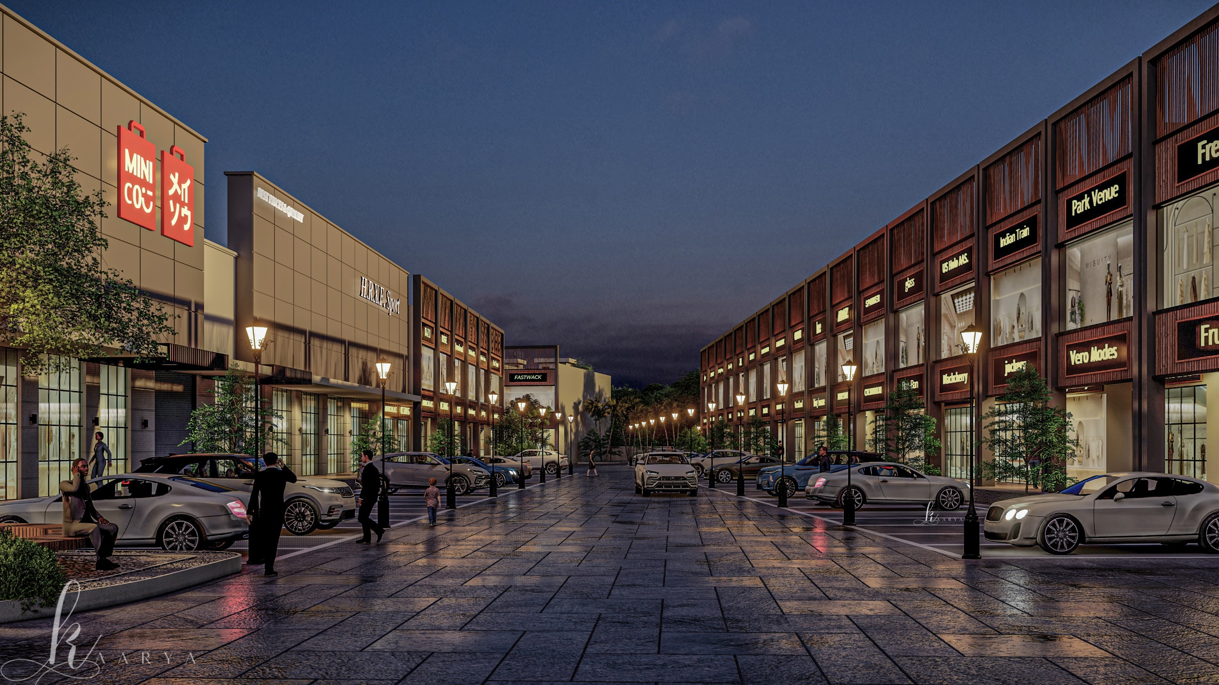
7. Fiber Optic Cable Network:
11. Roads and Pathways:
High-speed fiber optic cable network for internet and communication services.
Well-designed roads and pathways for vehicular and pedestrian traffic.
Proper road markings, signage, and lighting for safety.
Sidewalks, crosswalks, and pedestrian-friendly features for walkability.
8. Sewer Line:
12. Street Lighting:
Underground sewer lines for efficient waste disposal.
Manholes and access points for maintenance and inspections.
Proper drainage system to prevent waterlogging and sewage backup.
Street lights along roads and pathways for visibility at night.
Energy-efficient LED lighting to reduce electricity consumption.
Timers or sensors for automatic control of lighting.
9. Sewage Treatment Plant (STP):
13. Electrical Layout and Cabling:
Design and installation of an efficient electrical layout to meet the power requirements of the commercial outlet and its occupants.
Use of quality electrical cables and components to ensure safe and reliable electricity supply throughout the premises.
Integration of energy-efficient lighting solutions and smart electrical systems for optimal energy management and cost savings.
On-site sewage treatment plant for wastewater management.
Treatment processes to purify and recycle wastewater.
Compliance with environmental regulations for safe disposal of treated effluent.
10. Water Works:
Water supply infrastructure including pipelines, pumps, and storage tanks.
Potable water distribution system.
Water quality monitoring and testing to ensure safe drinking water.
14. Waste Management System:
Waste collection points for garbage disposal and recycling.
Recycling bins for segregating recyclable materials.
Regular waste collection services to maintain cleanliness.

Slide 10
Your Gateway to a Beautiful Project Site
Welcome to Alvista Time Square
Step into the 6.37 acres of luxury
Discover anchor stores offering unparalleled shopping experiences
Convenience at Your Fingertips
Enjoy drive-thru convenience for seamless shopping
Benefit from ample parking spaces for stress-free visits
Embrace Nature
Immerse yourself in abundant green spaces
Relax in green open seating areas within the bustling city
Prime Investment Opportunity
Prime location ensures high footfall and visibility for potential businesses.
Perfect opportunity for investors looking to capitalize on the upcoming transportation hub.
Your Gateway to a Beautiful Project Site
Experience the luxury and convenience of Alvista Time Square

